Slide 1

MMDE 11-150 Web Design
Lecture 5
→Site Design Continued
Semester 102
Dr. James Birt

Slide 2
Announcements
Quizzes (All been shifted to one week later)
New structure Week (4, 6, 8, 10, 12)
W4 (1&2)
W6 (3&4)
W8(5&6)
W10(7&8)
W12 (9&10)
Assignment Due Week 6!!!!

Slide 3
Outline
When Site Design Goes Bad
Colour Associations
Typography
Navigation
Readings: http://www.w3.org/standards/webdesign/
Make sure you become familiar with the W3C standards on webdesign

Slide 4
When Site Design Goes Bad
www.angelfire.com/super/badwebs/main.htm
What are your thoughts on this website?

Slide 5
Colour Associations

Slide 6
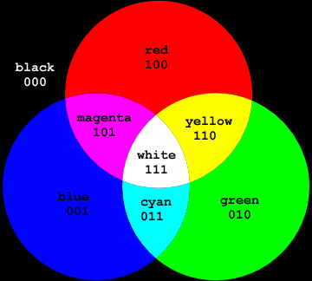
Colour Terminology (Hue)
Hue = colour with no black white or grey added

Slide 7
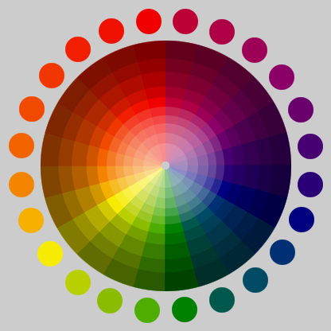
Colour Terminology (Tint & Shade)
Tint = hue with white added
Shade = hue with black added

Slide 8
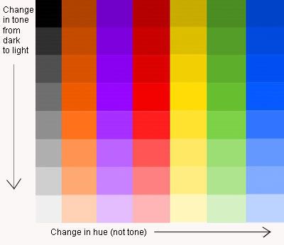
Colour Terminology (Tone)
Tone = hue with grey added

Slide 9
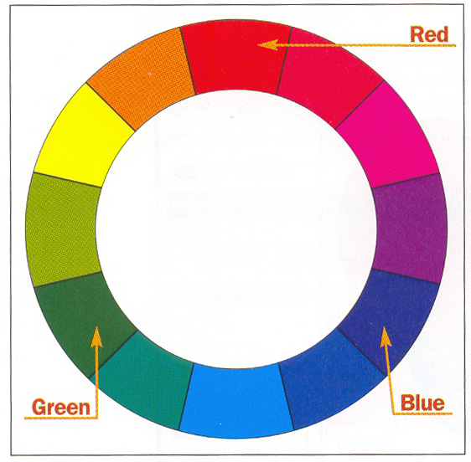
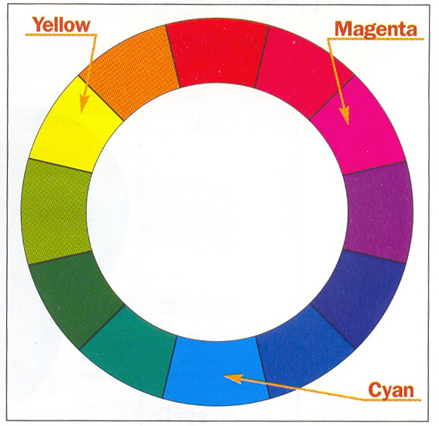
The Colour Wheel
The colour wheel is an ordered progression of hues (or colours) that helps a designer easily understand and select colour combinations.
Primary colours are Red, Green, Blue and are used on screen
Secondary Colours are an equal mixture of the primary colours. Cyan, Magenta and Yellow are used for print.
9
Notes:
6/9/2010
MMDE11-150 Semester 082
9

Slide 10
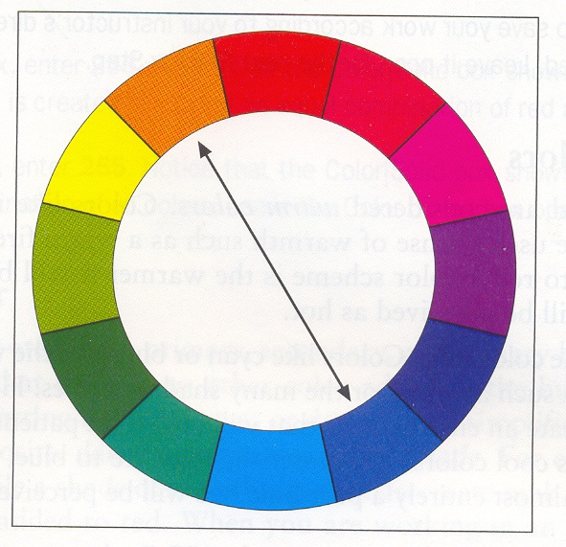
Colour on the Web
Complimentary colours are directly opposite each other.
When these colours are placed side by side they provide a good contrast.

Slide 11
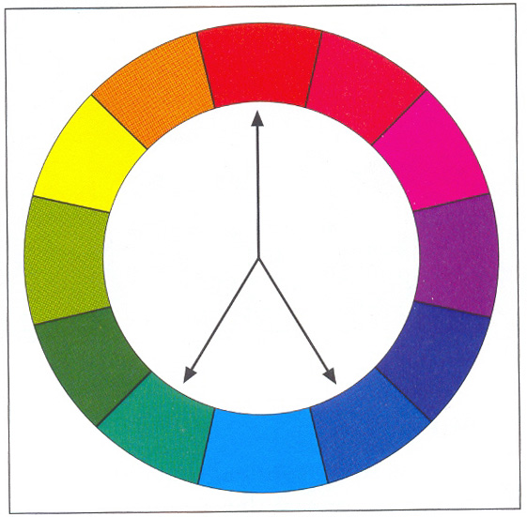
Split Complimentary
Split Complimentary form an uneven triangle.
The three colours form an instant colour scheme that is pleasing to the eye.
Preferably use the two colours closest to one another, and the colour further away as an accent colour.
Notes:
6/9/2010
MMDE11-150 Semester 082
11

Slide 12
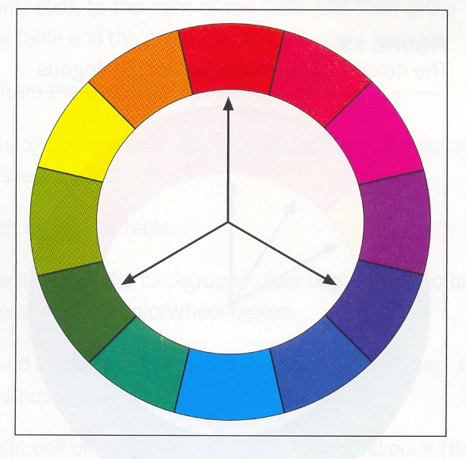
Triad Colours
Three colours that are an equal distance from each other on the colour wheel.
Triad colour schemes work well in giving an equal amount of contrast between the three colours.
Notes:
6/9/2010
MMDE11-150 Semester 082
12

Slide 13
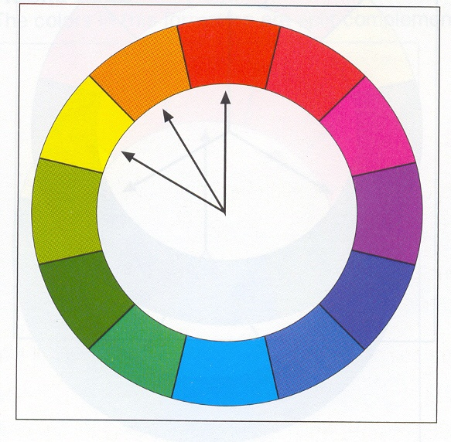
Analogous Colours
Three colours that are side by side work well together but do not provide strong contrast.
Would depend on the message to be conveyed to the audience.
Notes:
6/9/2010
MMDE11-150 Semester 082
13

Slide 14
Monochromatic Colour Scheme
Monochromatic means one single colour (Mono = one) (Chrome = colour)

Slide 15
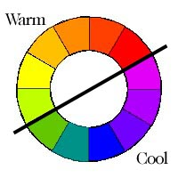
Colour temperature
Warm colours - add red
Cool colours - add blue
Pastels are considered calming to the phsyc.
Notes:
6/9/2010
MMDE11-150 Semester 082
15
Red next to blue will make the blue recede
Warm reds and orange seem to come forward
Warm colours are considered Harmonious colours.
Can lack visual variety unless used with other colours.
But always think about individual meaning of colours.
Cool Colours especially blue can recede into the background.
Pastels are considered calming to the phsyc.

Slide 16
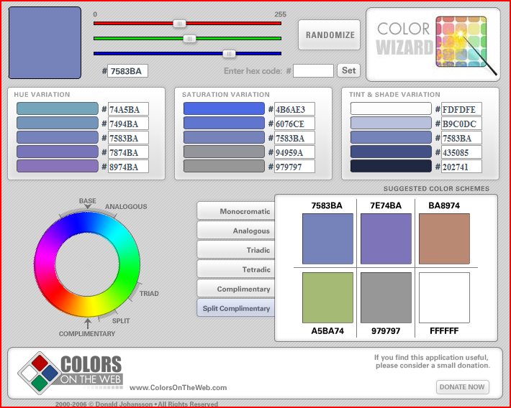
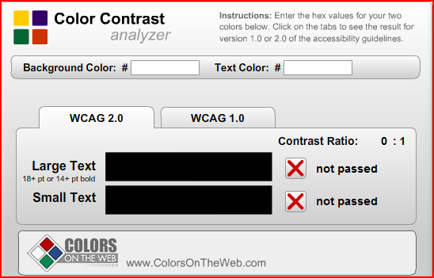
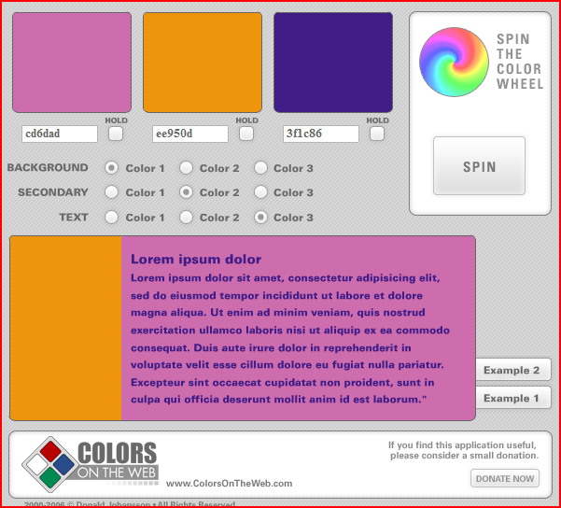
Demo Colour
Check out: http://www.colorsontheweb.com/
http://www.colorsontheweb.com/colorwizard.asp
http://www.colorsontheweb.com/colorcontrast.asp
http://www.colorsontheweb.com/colorwheel.asp

Slide 17
Typography and the Web

Slide 18
Web Type ‘on-the-fly’
Web pages are built ‘on the fly’ each time they are loaded into a web browser.
Each line of text, each headline, and each unique font and style are re-created by a complex interaction of the web browser, the web server, and the operating system of the reader’s computer.
Remember: Web page layouts and typography are only suggestions of how your pages should be rendered—you’ll never know exactly how they will look on the reader’s screen.
Notes:
The process is fraught with the unexpected: a missing font, an out-of-date browser, a peculiar set of font preferences designated by the reader.

Slide 19
Revisit from Week 4:Serif and Sans Serif
SERIF
Serif (Times New Roman) Serif (Georgia)
SANS SERIF
Sans Serif (Arial) Sans Serif (Verdana)

Slide 20
Revisit from Week 4:Legibility on Screen
Some typefaces are more legible than others on the screen.
A traditional typeface such as Times New Roman (a SERIF font) is considered to be one of the most legible on paper, but at screen resolution its size is too small and its shapes look irregular.
Screen legibility is most influenced by the x-height (the height of a lowercase "x") and the overall size of the typeface.
ARIAL (a SANS SERIF) font is considered easier to read on screen.
Notes:
6/9/2010
MMDE11-150 Semester 082
20

Slide 21
Revisit from Week 4:Designed for the screen
Typefaces such as Georgia and Verdana were designed specifically for legibility on the computer screen; they have exaggerated x-heights and are very large compared to more traditional typefaces in the same point size.
These fonts offer excellent legibility for Web pages designed to be read directly from the screen.
These fonts can look massive and clumsy when transferred to the high-resolution medium of print.
Notes:
6/9/2010
MMDE11-150 Semester 082
21

Slide 22
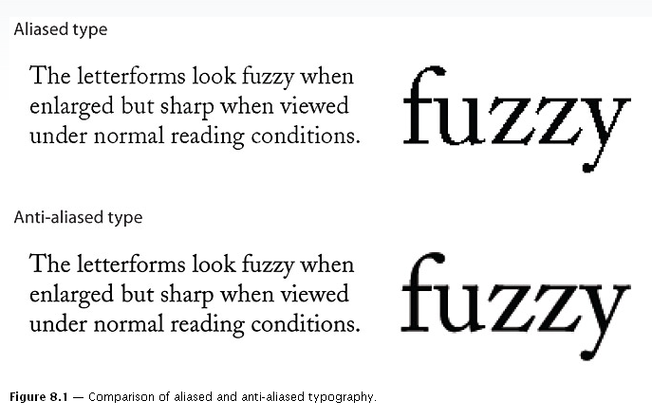
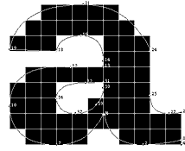
Anti- Aliased Type
Type on screen is displayed at a much lower resolution – techniques include Anti- aliasing and Hinting to improve readability- we recognise a more smooth contour
http://www.microsoft.com/typography/default.mspx

Slide 23
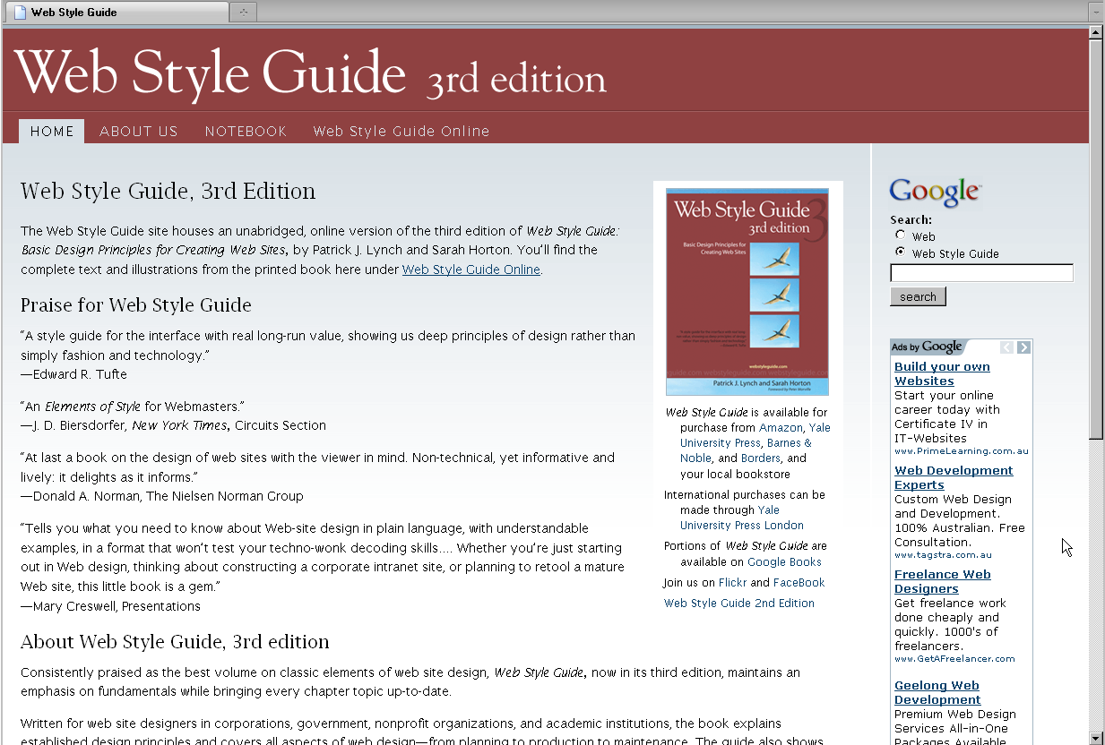
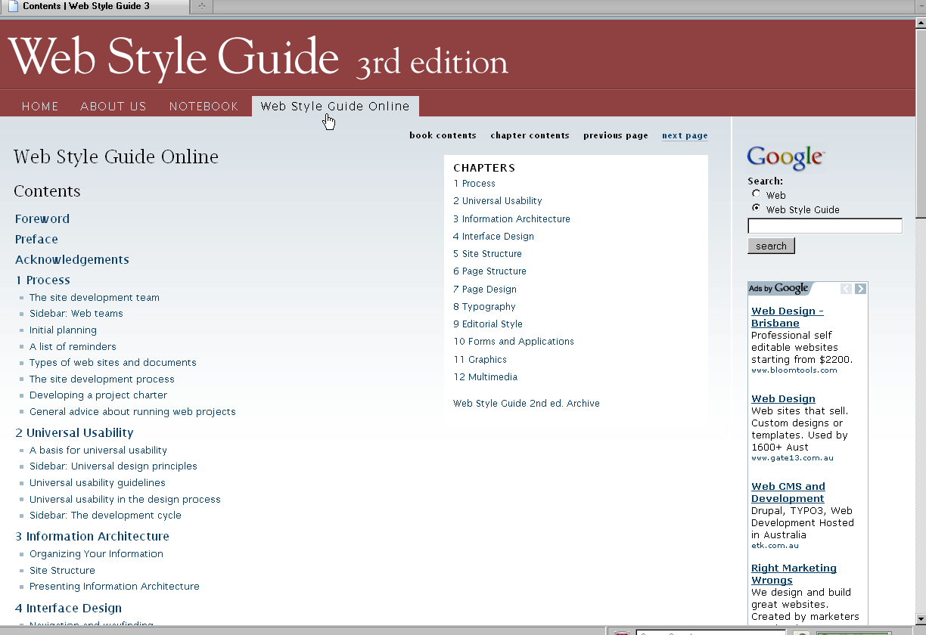
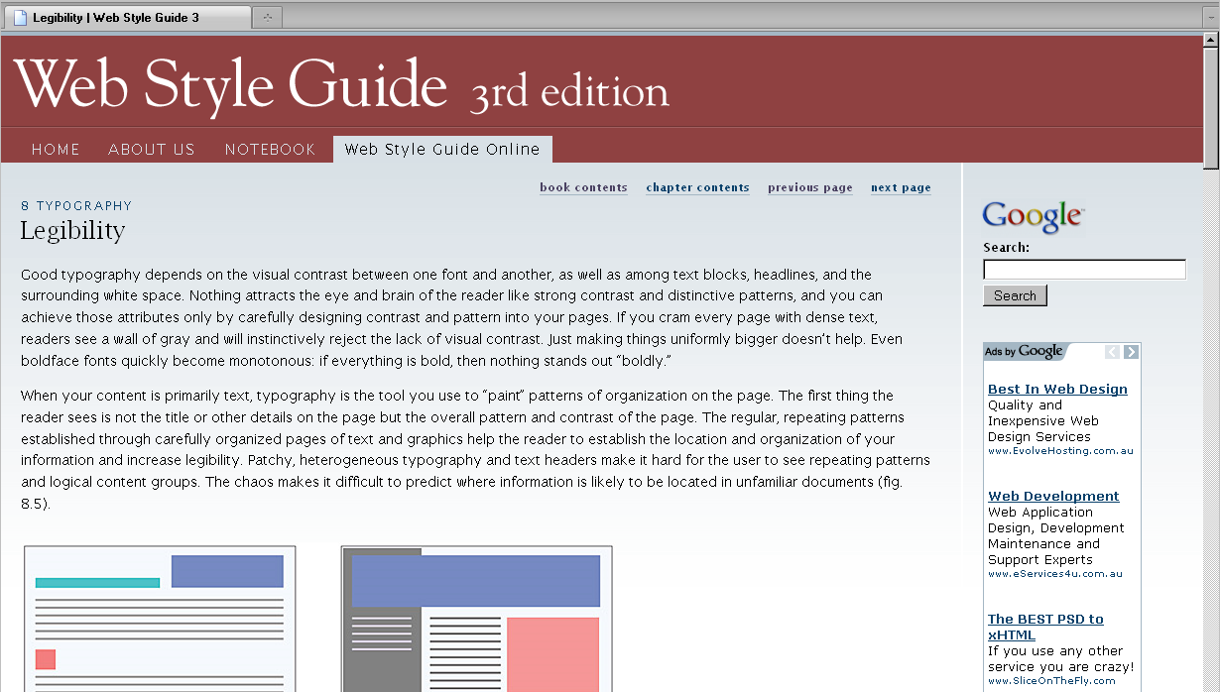
Fonts
Your pages will look cleaner when you choose fewer fonts and sizes of type.
Decide on a font for each level of importance.
Communicate hierarchy with size, weight colour.

Slide 24
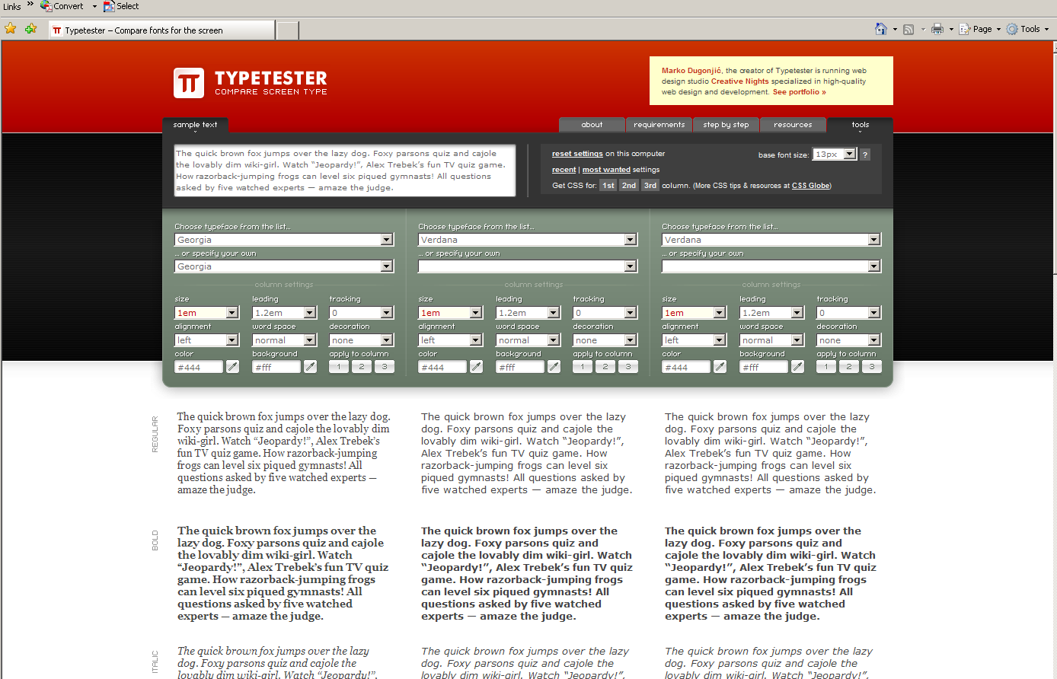
Demo Type
If you want to see how different fonts layouts appear go to : http://www.typetester.org/
Notes:
6/9/2010
MMDE11-150 Semester 082
24
Choose fewer fonts for a cleaner look

Slide 25
Navigation

Slide 26
Website Navigation
Consider Mystery Meat Navigation:
http://www.webpagesthatsuck.com/mysterymeatnavigation.html
Users typically only follow 10% of links they encounter even when they are obvious to them

Slide 27
Website Navigation
Images as links are also known as image maps.
Include a brief description/ instruction for the user
For example: Click on thumbnail to view larger image.. http://www.pixar.com/index.html
Notes:
Highly effective for saving users additional searching

Slide 28
The Key is good Navigation
Offer alternative navigation.
Every page should have a consistent footer, ensure the footer has text-only links.
For example: your contact information: email address, your phone number etc.
Having site page navigation in your footer is an old fashioned navigation method but may still be used
We expect page footers in books, so we are presenting the viewer something they are already familiar with.
Notes:
However, due to its interactivity, the web can provide a lot more useful information in the page footer, therefore making your website more user-friendly.

Slide 29
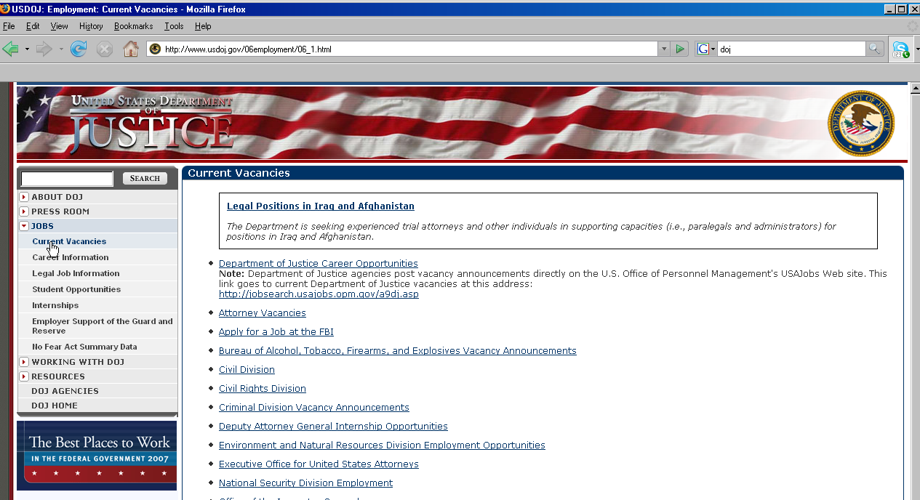
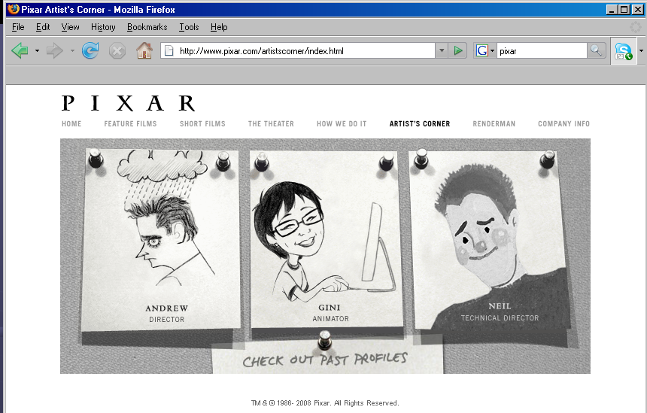
Navigation Bars
Clear Navigation Bars, either text or graphics make it obvious to the user where they are and where to go next.
http://www.usdoj.gov/06employment/06_1.html
http://www.pixar.com/artistscorner/index.html
Notes:
Current vacancies is shown at the top of the page/ title/ and in menu – also giving clues with colour and also supplies other options.
Tabs provide horizontal navigation

Slide 30
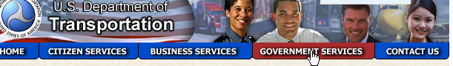
Navigation Bars
The graphical navigation bar adds visual interest.
Always include text links and alternative tags for accessibility.

Slide 31
Navigation Bars
Adobe Flash can be combined with XHTML to create interactive navigation
http://www.loc.gov/wiseguide/may08/index-flash.html
Java Applets and Dynamic HTML ( DHTML) can also be used to create similar interactive effects.
31

Slide 32
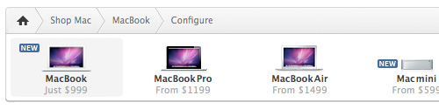
Bread Crumb Trail
A “breadcrumb” (or “breadcrumb trail”) is a type of secondary navigation scheme that reveals the user’s location in a website or Web application
Effective visual aid that indicates the location of the user within the website’s hierarchy
Breadcrumbs reduce the number of actions a website visitor needs to take in order to get to a higher-level page
Improves site usability
The term comes from the Hansel and Gretel fairy tale in which the two title children drop breadcrumbs to form a trail back to their home
www.apple.com

Slide 33
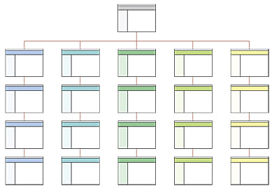
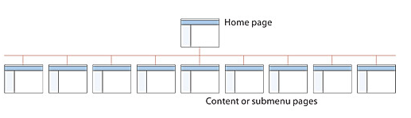
When to use Bread Crumb
Large website with many pages
Hierarchically arranged pages
Example: E-commerce websites
DONT USE:
Single-level websites
No Logical Hierarchy
A good way to determine if a website would benefit from a bread crumb is to design a sitemap or a structure chart
Breadcrumb navigation should be regarded as an extra feature and shouldn’t replace primary navigation menus
Use in Situations of Hierarchy
Don’t use on single level

Slide 34
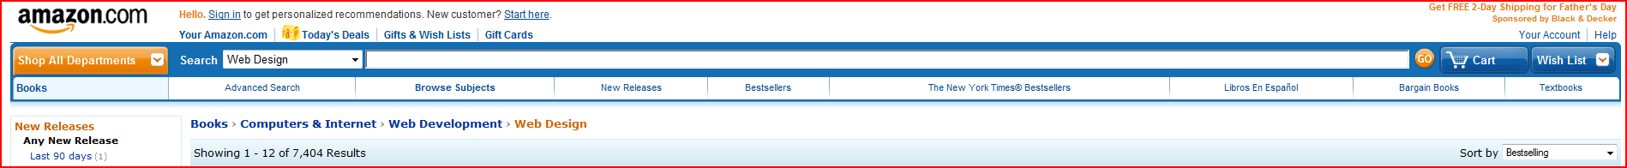
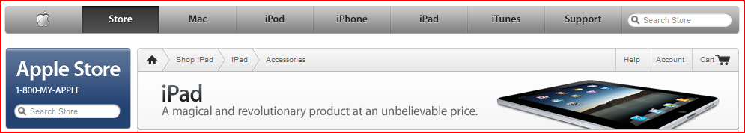
Examples of Bread Crumbs

Slide 35
Anchors
Anchor text is the clickable text part of a hyperlink. It usually gives visitors or search engines important information on what the page being linked to is about.
Anchor text should be short
Users scan the page for link
Links act as target for user's eye scan—too many words will prevent the user from understanding

Slide 36
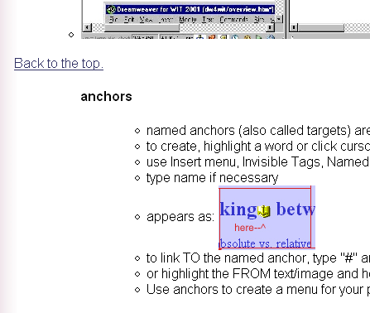
Anchors
Add additional words around anchor text to explain the link— you cannot expect a user to follow a link just to learn if it's useful.
Page anchors can be used to link to text within a long scrolling page
http://www.bramsturf.com.au/
36

Slide 37
When Site Design Goes Well
http://www.csszengarden.com/
http://www.coolhomepages.com/

